Slide 1
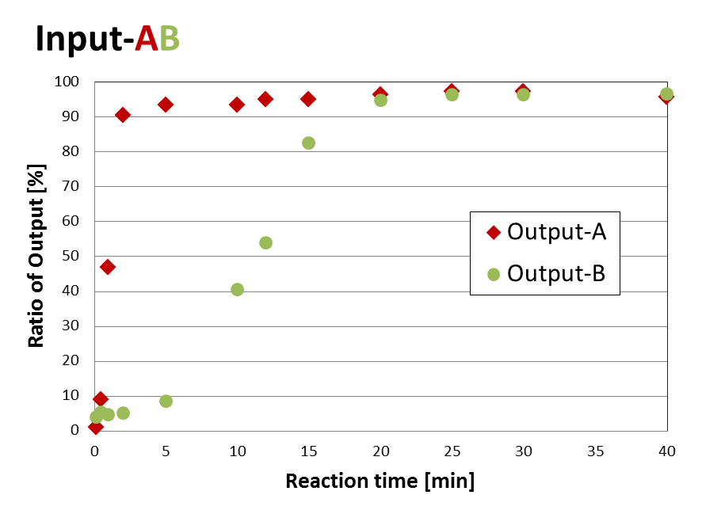
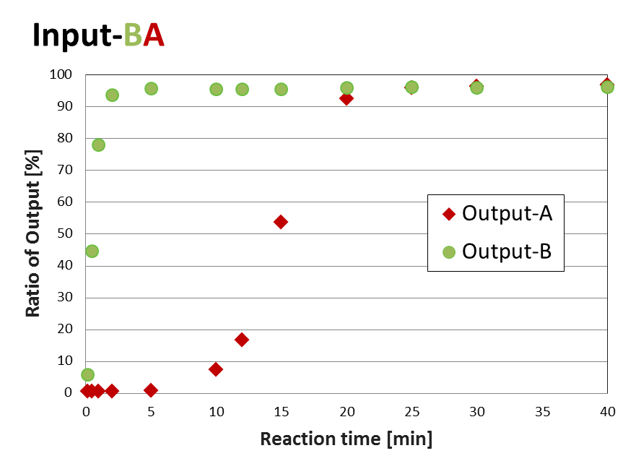

Slide 2
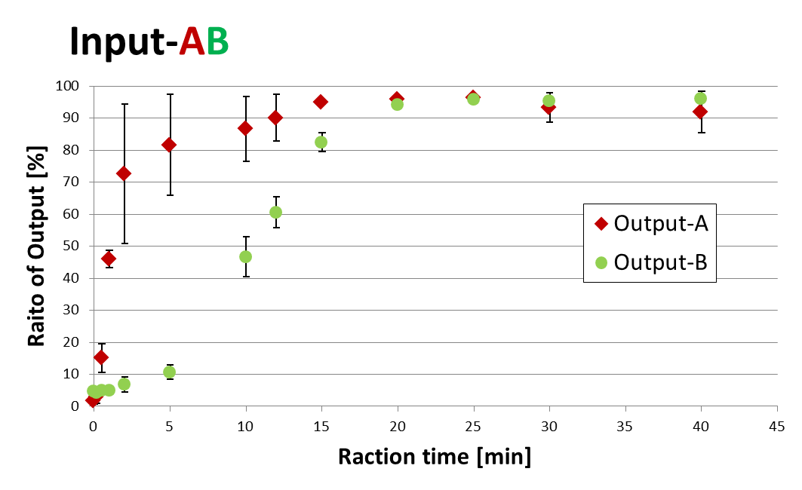
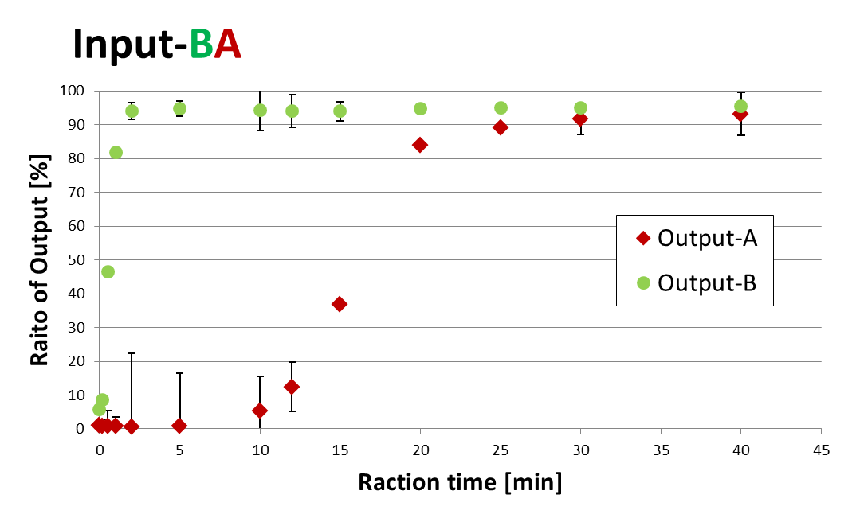

Slide 4
Lane No. | 1 | 2 | 3 | 4 | 5 | 6 | 7 | 8 | 9 | 10 | 11 | 12 | 13
Reaction Time [min] |  | 1/6 | 1/2 | 1 | 2 | 5 | 10 | 12 | 15 | 10 | 25 | 30 | 40
Lane No. | 1 | 2 | 3 | 4 | 5 | 6 | 7 | 8 | 9 | 10 | 11 | 12 | 13 | 14 | 15 | 16 | 17 | 18
Reaction Time [min] | 0 | 1/6 | 1/2 | 1 | 2 | 5 | 10 | 12 | 15 | 20 | 22 | 25 | 30 | 35 | 40 | 45 | 50 | 60

Slide 5
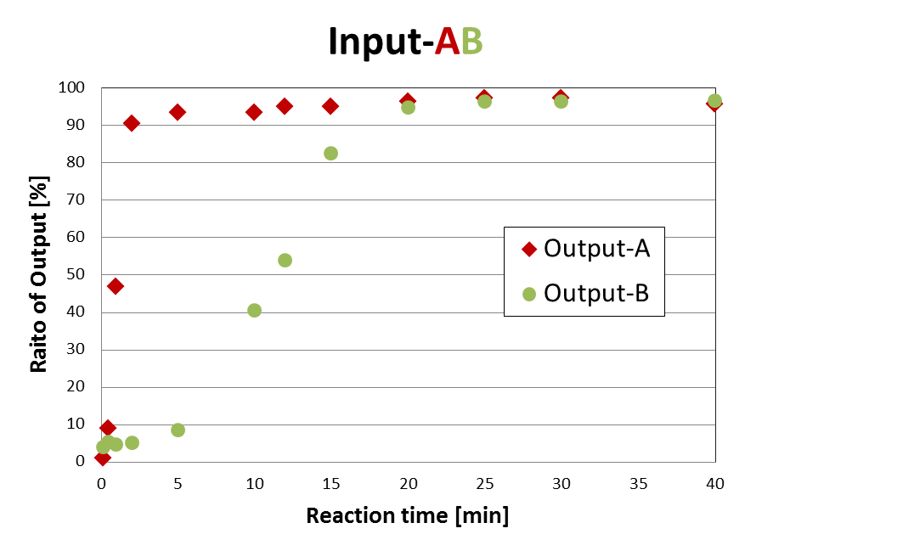
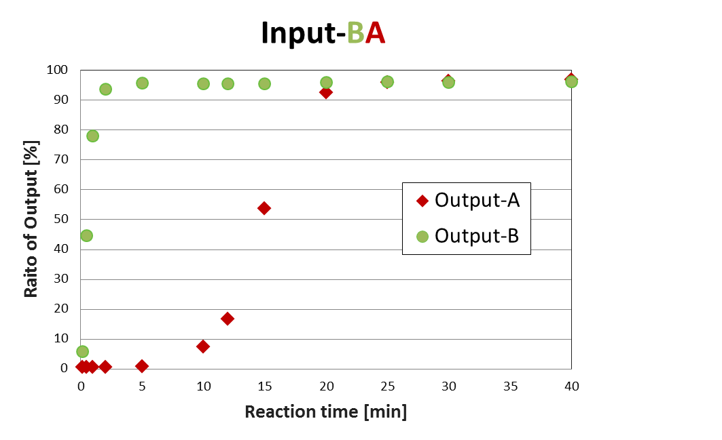
Lane No. | 1 | 2 | 3 | 4 | 5 | 6 | 7 | 8 | 9 | 10 | 11 | 12
Reaction Time [min] | 1/6 | 1/2 | 1 | 2 | 5 | 10 | 12 | 15 | 10 | 25 | 30 | 40
Lane No. | 1 | 2 | 3 | 4 | 5 | 6 | 7 | 8 | 9 | 10 | 11 | 12
Reaction Time [min] | 10 | 30 | 1 | 2 | 5 | 10 | 12 | 15 | 20 | 25 | 30 | 40
Transducer A
Output A

Slide 6
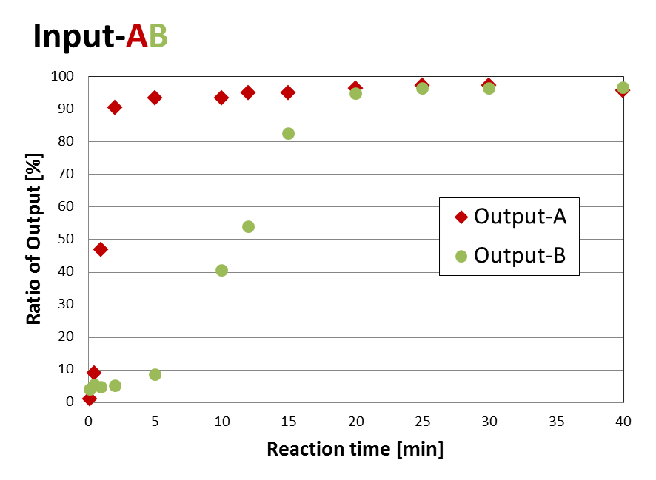
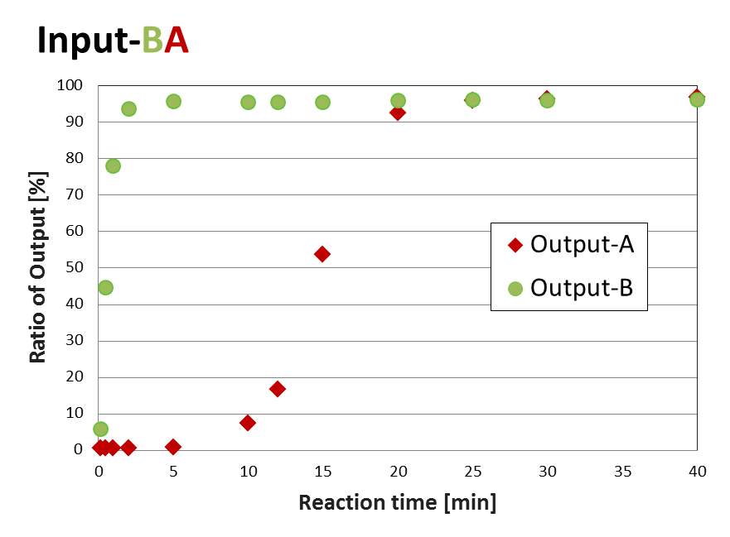
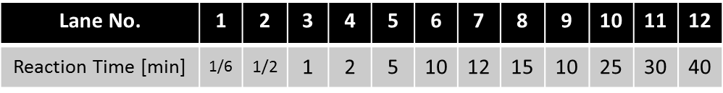
Input
Input
Transducer B
Transducer B
Transducer A
Transducer A
Output B
Output B
Output A
Output A

Slide 7
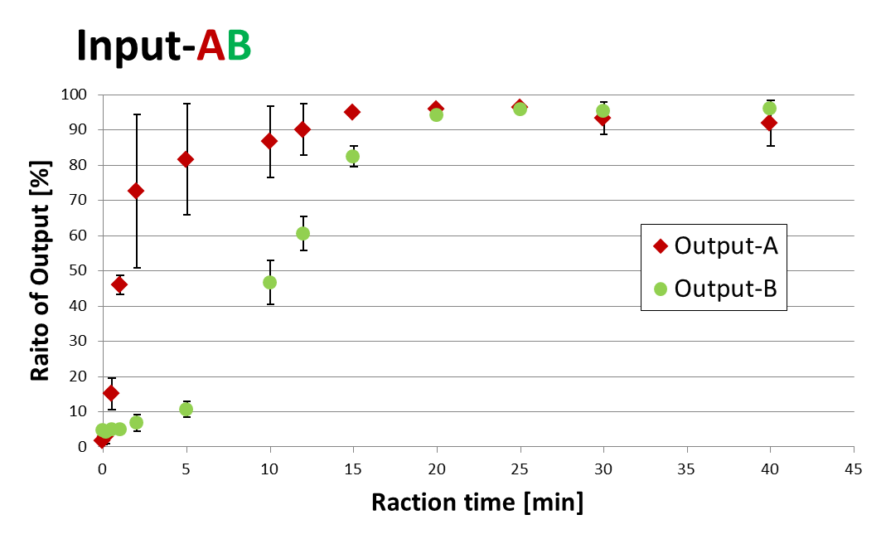
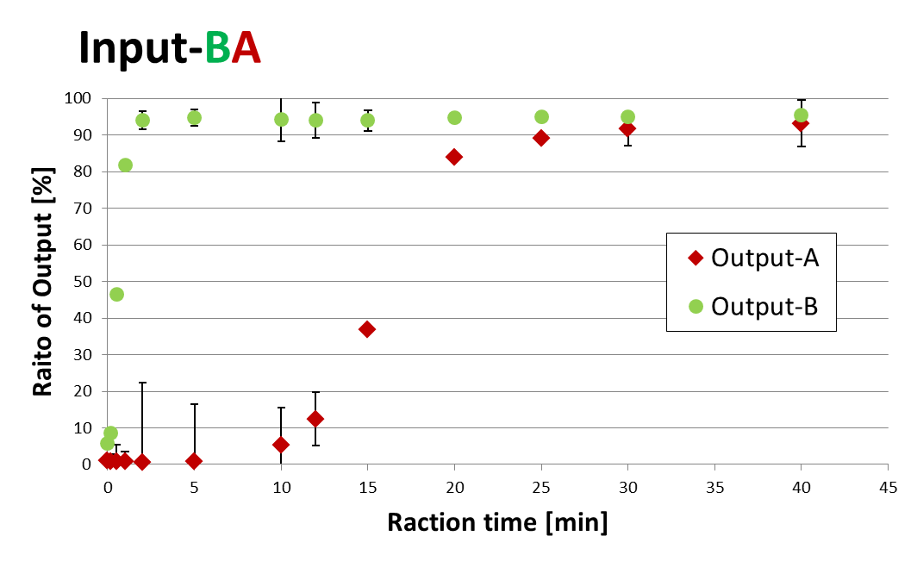
Input
Input
Transducer B
Transducer B
Transducer A
Transducer A
Output B
Output B
Output A
Output A

Slide 8
Input
Input
Transducer B
Transducer B
Transducer A
Transducer A
Output B
Output B
Output A
Output A

Slide 9
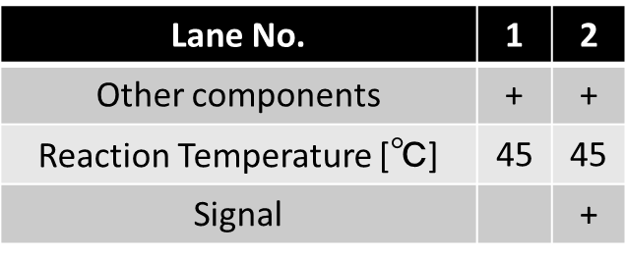
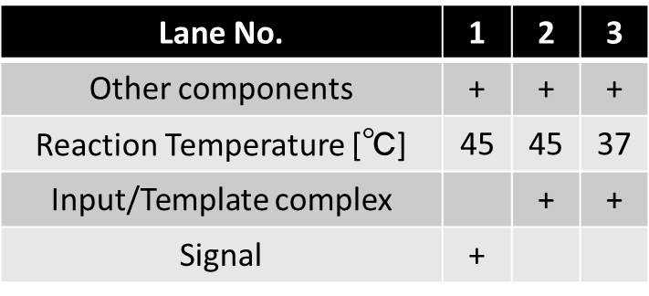
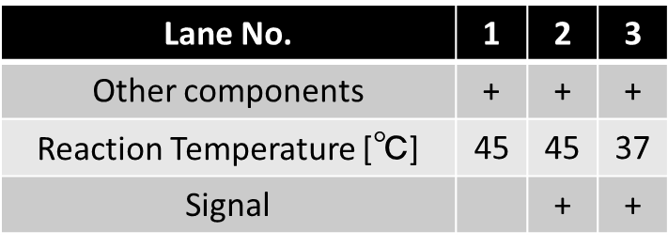

Lane No. | 1 | 2 | 3
Other components | + | + | +
Reaction Temperature [℃] | 45 | 45 | 37
Input/Template complex |  | + | +
Lane No. | 1 | 2 | 3
Other components | + | + | +
Reaction Temperature [℃] | 45 | 45 | 37
Signal |  | + | +
Updated Complex
Input/Template complex
Waste
Output complex
Output
Signal
Other components :
Input
Gate
Polymerase
EcoRI
dNTP.
Other components :
Input/Template complex
Polymerase
Nickase
dNTP.
Other components :
Transducer
Polymerase
dNTP
Notes:
Readとrelease縦と横が揃っているよ

Slide 10
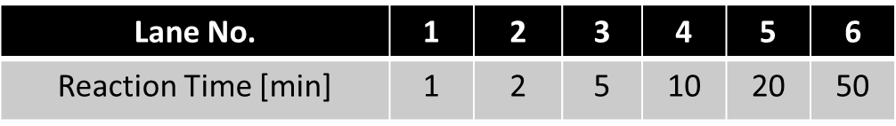
Lane No. | 1 | 2 | 3 | 4 | 5 | 6 | 7 | 8
Enzymes & dNTP | + | + | + | + | + | + | +
Transducer | + | + | + | + | + | + | +
Output |  |  |  |  |  |  |  | +
Template | + | + | + | + | + | + | +
Input |  | + | + | + | + | + | +
Reaction Time [min] |  | 1 | 2 | 5 | 10 | 20 | 50
Transducer-A
Output-A

Slide 11
Lane No. | 1 | 2 | 3 | 4 | 5 | 6 | 7
Enzymes & dNTP | + | + | + | + | + | + | +
Transducer | + | + | + | + | + | + | +
Output
Template | + | + | + | + | + | + | +
Input |  | + | + | + | + | + | +
Reaction Time [min] |  | 1 | 2 | 5 | 10 | 20 | 50
Transducer-A
Output-A

Slide 12
Signal
Lane No. | 1 | 2 | 3 | 4 | 5 | 6
Reaction Time [min] | 1 | 2 | 5 | 10 | 20 | 50

Slide 13
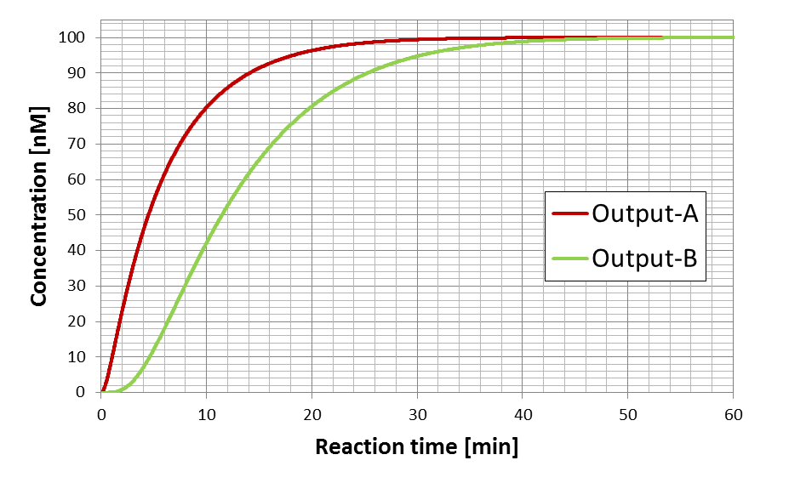

Slide 14
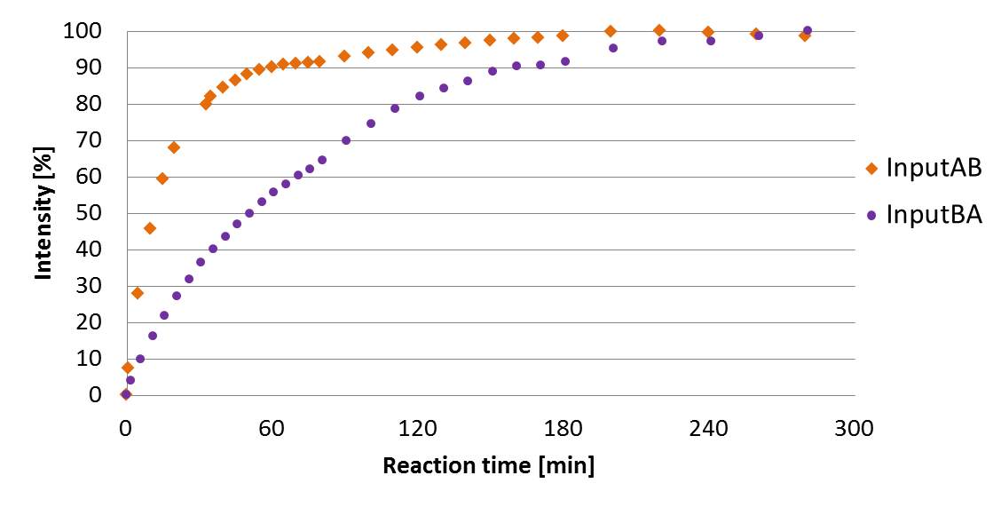
Input

Slide 15
Input

Slide 16
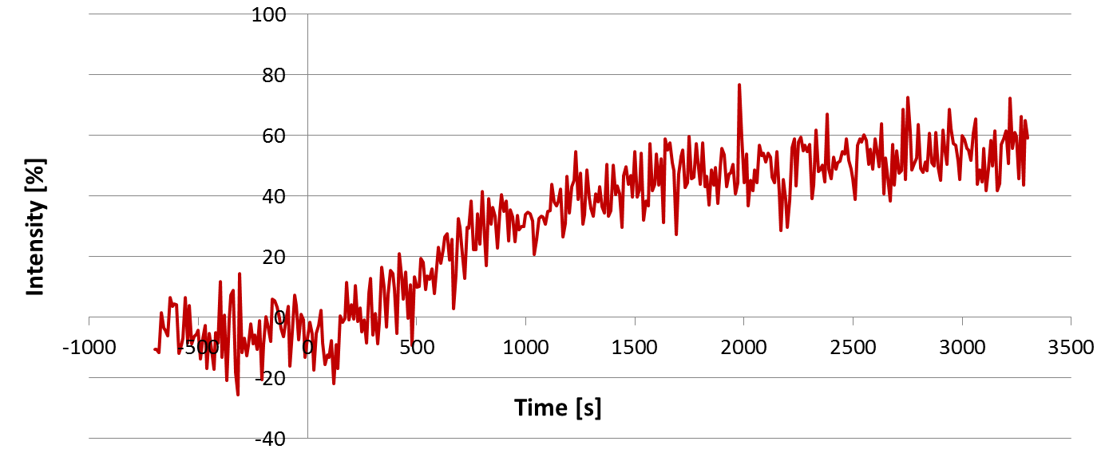
Input

Slide 17
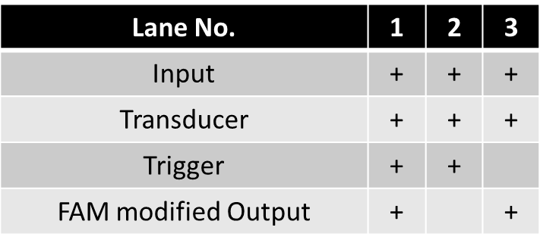
Transducer
Output
Lane No. | 1 | 2 | 3
Input | + | + | +
Transducer | + | + | +
Trigger | + | +
FAM modified Output | + |  | +

Slide 18
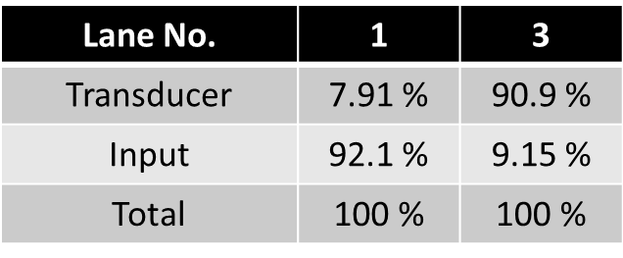
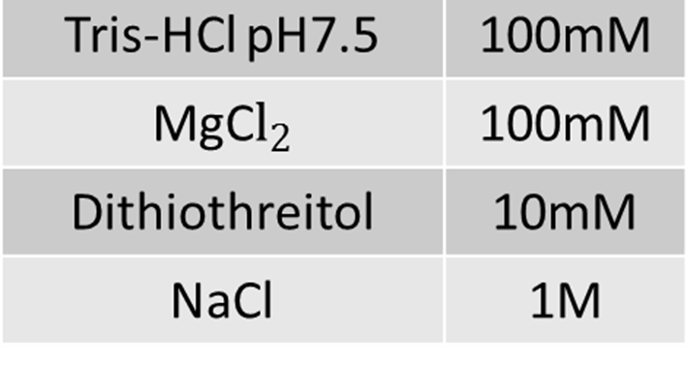
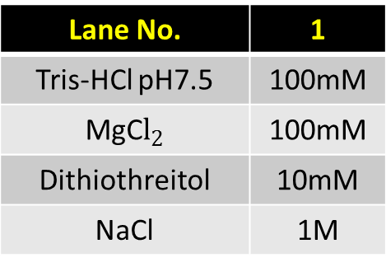
Lane No. | 1
Tris-HCl pH7.5 | 100mM
MgC$l_{2}$ | 100mM
Dithiothreitol | 10mM
NaCl | 1M
Lane No. | 1 | 3
Transducer | 7.91 % | 90.9 %
Input | 92.1 % | 9.15 %
Total | 100 % | 100 %

Slide 19
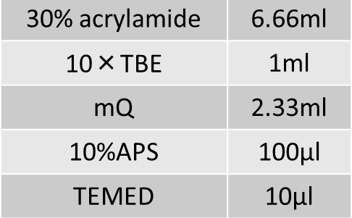
Lane No. | 1
30% acrylamide | 6.66ml
10×TBE | 1ml
mQ | 2.33ml
10%APS | 100μl
TEMED | 10μl

Slide 20
